Slide 1
Multi Thread with ASP.NET, Java Spring
Request Work Thread 1
Here, We Call Multi Thread
Request Work Thread
Request
Host
Process
(TCP Thread Per N)
Request Work Thread
Request Work Thread
Request Work Thread N
Limitation N Thread

Slide 2
Non-Blocking Single Thread with Node.js
But, Here, Multi Thread,
Use Thread Pool
Non Blocking Process Chain Thread 1
Here, We Call Single Thread
Non Blocking Process Chain Thread…
Request
Host
Process
(One TCP Thread)
Non Blocking
Process Chain.
(Event Queue)
Also, Use Thread Pool
Non Blocking Process Chain Thread…
No Limitation N Thread.
Use Queue.
Non Blocking Process Chain Thread…
Non Blocking Process Chain Thread N

Slide 3
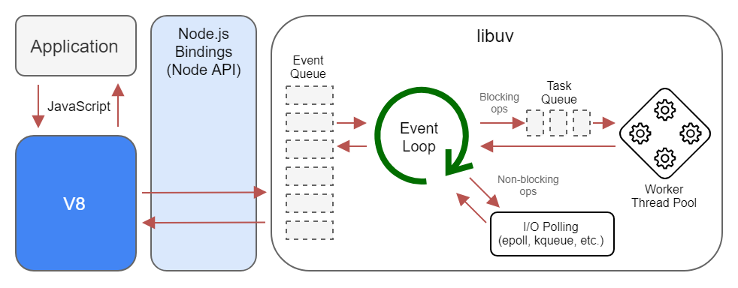
Non-Blocking Single Thread with Node.js
Non Blocking
Process Chain
(Event Queue)
Also, Use Thread Pool
Non Blocking Process Chain Start
Call Chain Method 1
Call Chain Method 2
Call Chain Method N

